Slide 1

Implementing an Electronic Health Record at the Central City Medical Group
Presented By:
Sheethal Sridhar

Slide 2

Reasons for implementing the EMR System
Enhances the Value: EMR enhances CCMG’s ability to perform their four pillar values effectively.
Operational Efficiency: EMR system would help to establish continuity, personalization, and integration of patient care.
Increases Accessibility: Allows access to patient files from any location assisting the on-the-go nature of CCMG.
Quality Care: Ability to determine the best practices in treating chronic disease management.
Information Management: Creating a centralized system to manage patients with multiple conditions.
Financial Enhancement: Allows CCMG to measure its quality of care to participate in pay-for-performance initiatives for additional funding and demonstrate the effectiveness of their care.

Slide 3




How CCMG was well positioned?
Work Culture: CCMG was a mission driven organisation with providers dedicated to work for a cause.
Size of the Organization: CCMG being a small group will help them to implement the EMR quickly.
Innovation: As the innovators of primary care they needed to continue in the direction of improving healthcare quality.
Leadership: Deb Moore, the CEO, had a very strong IT background, who understood the importance of technology in healthcare delivery.
Notes:
Lucky to get world leaders on health IT to educate them about the system
- Track record of innovation - Even though most players in the Technology & Operations strive to innovate, Ccmg Ehr has successful record at consumer driven innovation.

Slide 4

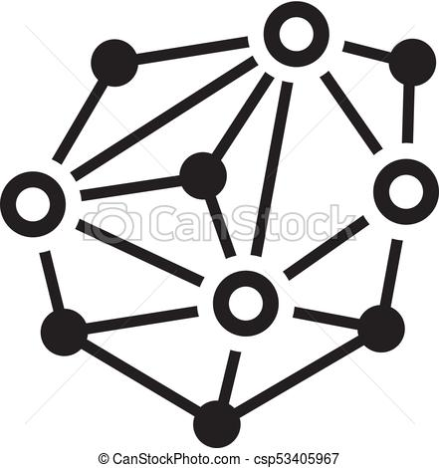
How CCMG was poorly positioned ?
Financial Status: CCMG being a small non profit organisation lacked funding as the revenue was declining because:
Contracts were being withdrawn.
Revenue from Capitation and Risk Sharing decreased.
Distributed Work Environment: Implementation of EHR could not be consistent due to CCMG’s operation in multiple locations, internet, disorganised documentation and patient history.
Staff shortage: There was no dedicated team for managing the implementation of EHR.
Notes:
office, nursing homes, house calls and hospitals- multiple locations

Slide 5
What Went Well During Implementation
Implementation of Office functions:
Scheduling
Check in
New Patient registration
Billing
Support from Industry: Education from leaders in health IT , Free consulting services from DOQ-IT, support by EMC and providers who volunteered to test the EHR’s smooth functioning.
Documentation: Conversion of paper based files into a centralised digital file system helped them retrieve and manage files quicker.
Workflow redesign: The tasks of the workers were reassigned as the EMR system automated some of the functionalities.
Example: An administrative assistant who formerly had transcribed dictation now took on other administrative responsibilities such as payroll, because the browse and drop-down menus of the EHR reduced the need for dictation.
Notes:
CCMG updated their 20 year old, antiquated process flow in conjunction with the roll out of the EMR System.
CCMG Physicians were quickly able to see the value in implementing the EMR System.
CCMG were very democratic in developing a plan for implementation.
CCMG to time to allow EMR vendors to demonstrate their systems.
Reduced patient throughput in order to allow providers to get used to the new systems

Slide 6
Current System: Improvement in Implementation
 | Shortcomings | Recommendations
Vendor Selection: Training: Testing: Finance: | Focus was on aesthetics of EMR system , instead of core functionality Only one week of training was provided at eCW site rather than CCMG’s workplace Skipping Load testing due to financial limitations Avoiding hiring external team, choosing a less expensive vendor, reducing the training and testing periods due to financial constraints | Vendor Selection should be based on experience in EMR industry, features provided and customer support Training for a longer period in the real environment with the real data and load to avoid glitches in early stages Performing A/B Testing will help discover major bugs in the system without damaging the existing system Individual and Institutional donations, request for government grants, collaborating with other non profit organizations can help them improve their financial status
Notes:
( providers used this not patients so not needed to beautify this)
Software glitch:
“Inking” function did not work causing issues in signing orders.
Quest Interface did not work, lab orders needed to be written on paper.
E-Prescribing did not work at first.
Clinical function cause numerous errors, which were the major reason to implement EHR. quality functions: disease registry,chronic disease mgmt, drug interactions etc
Did not account for unreliable internet access while trying to implement the system in the community.
No alternative available for night shift doctors at System shut down (from 12am to 6am).
Dedicated internal resource instead of hiring from outside.

Slide 7
Recommendation- Future Enhancements
Stabilize the existing system before intake of any new patients.
Change vendor: As the contract is for one year. Switch vendor if eCW does not improve their quality and service.
Incentivise physicians:
Provide incentives to physicians for increased workload.
Make few doctors as the brand ambassadors for the change to educate other doctors.
Increase Staff:
Hire technical assistants - Reduce the workload on the physicians by delegating the digital entry tasks to a technical assistant
Maintain an in house customer support.
Notes:
ater system more to assist physicians
Hire an EMR Specialist to assist physicians. Physicians used to intentionally fill out only the important details from patients reports and skip the other part of patient history which might have been useful.
Maintain items in the EMR Process that are going well and return to the paper system for items that are not going well. Find how to fix and reimplement those processes.

Slide 8
Thank You

